Slide 1
DIAGRAMS
SEQUENCE DIAGRAM ACTIVITY DIAGRAM USE CASE DIAGRAM PACKAGE DIAGRAM COMPONENT DIAGRAM CLASS DIAGRAM

Slide 2
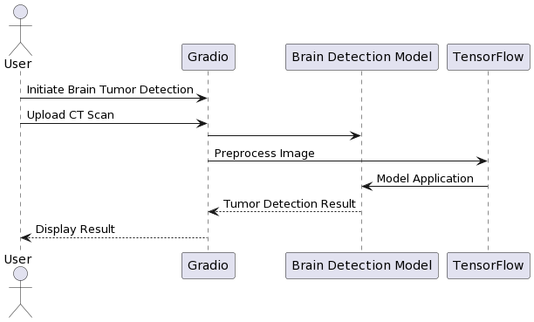
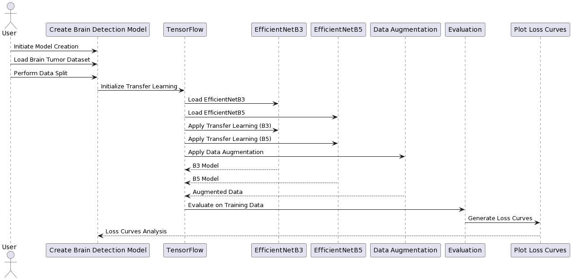
SEQUENCE DIAGRAMS

Slide 3
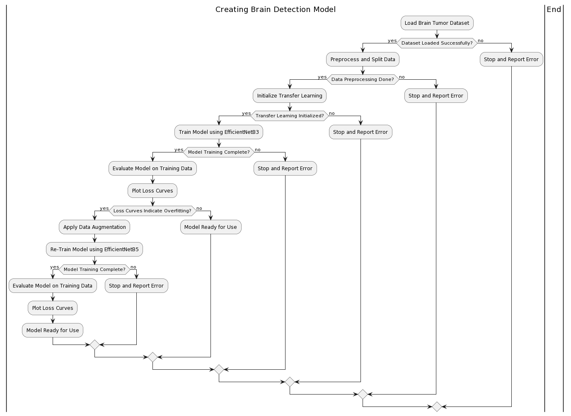
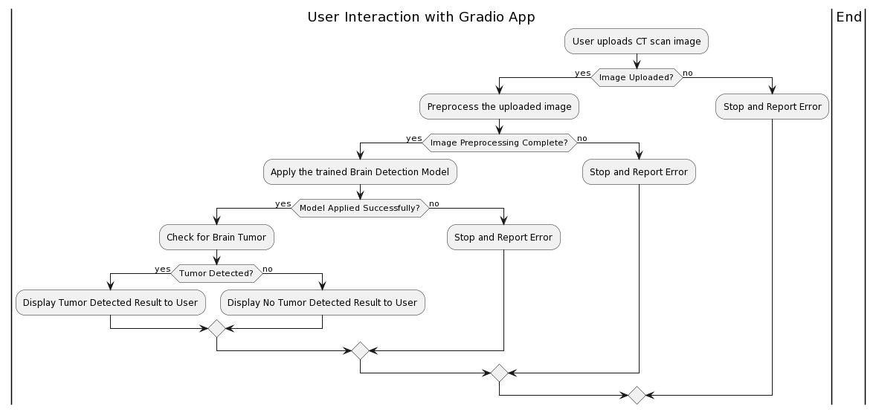
ACTIVITY DIAGRAMS

Slide 4
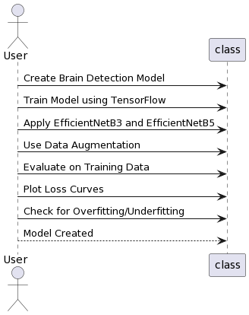
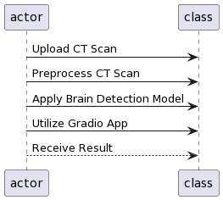
USE CASE DIAGRAM

Slide 5
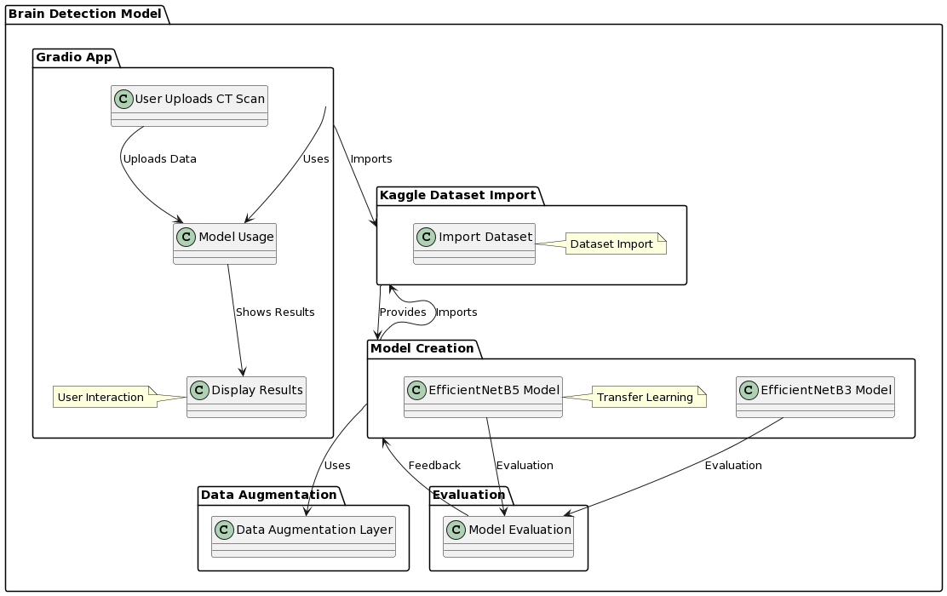
PACKAGE DIAGRAM

Slide 6
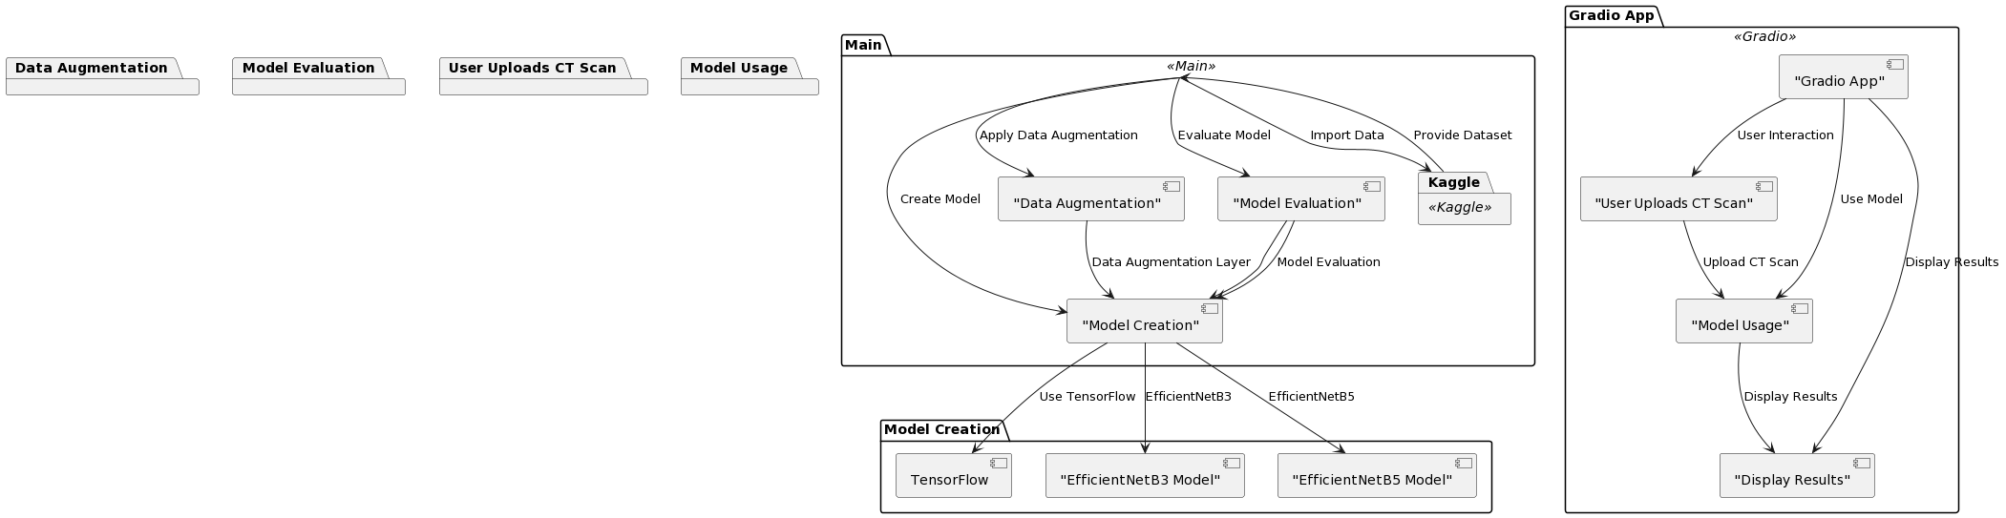
COMPONENT DIAGRAM

Slide 7
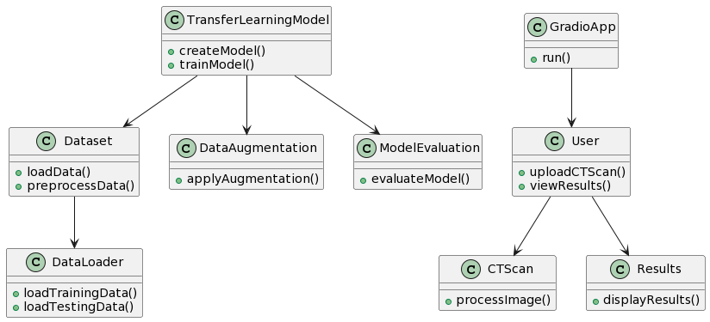
CLASS DIAGRAMS

